Slide 1
ICT Communications Lesson 1: Using the Internet and the World Wide Web

Slide 2
Objectives – Lesson 1
2.1.1: Define “Internet,” and explain how it uses protocols and data packets to enable computers to communicate.
2.1.2: Identify requirements for connecting to the Internet.
2.1.3: Compare various Internet connection types (e.g., dial-up, cable, DSL, broadband, wireless, fiber-optic).
2.1.4: Describe Internet addressing, including domain names, IP addresses, DNS.
2.1.5: Compare various top-level domains (.com, .org, .edu, .gov, .net, .mil).
2.1.6: Distinguish the Internet from the World Wide Web.
2.1.7: Explain how web browsers and web servers interact to provide information to users.
2.1.8: Define “Uniform Resource Locator (URL)” and identify associated protocols, including http//:, ftp//:, mailto//:.
2.1.9: Use various techniques and tools to navigate and access information on the Web, including hyperlinks, Web page and browser components, file downloads.

Slide 3
Terminology – Lesson 1
Client - a single user computer
Cloud – storage space on the Internet that anyone can use or access
DNS – reconciles the IP address of a Web site with its common name URL
Hyperlink – a process that enables a user to mouse click a “link” on a Web page and that link will take them to another location on that page, another Web page or even another Web site
Internet – connection of millions of devices all around the world based on TCP/IP
IP Address – the unique numerical number assigned to each device that is attached to the Internet
Modem – a device used to connect a computer or server to an ISP
Network – a group of 2 or more computers connected together to share information or resources
Packet – a piece of information
Server – any computer that 2 or more devices can connect and exchange data or resources with at the same time
TCP/IP – communication rules that enable 2 or more devices to communicate with each other as a network
URL – common name used for a Web site and consists of the 1) server name 2) domain name 3) top level domain
Web browser – client based software that enables a computer to read and interact with a Web site
Web page – a single file that is based on HTML protocol
Website – a collection of related Web pages
Wi-Fi – broadband wireless (radio frequency) network connection
World Wide Web – the collection of information based on HTML that is accessed via the Internet

Slide 4
Internet vs World Wide Web
Internet
World Wide Web
A very large network of networks.
Networks consist of servers that store information accessed by various clients.
Essentially hardware machines and data.
A system of tools and services that enable us to access the information on the Internet.
Web browsers — a tool that retrieves the information using the Internet
Hyperlinks: a key part of the Web which connect data resources together, enabling users to "browse" from page to page.

Slide 5
Other Services
E-mail (Mailto://)
Mailing lists
Instant Messaging
Chat rooms
Voice over Internet Protocol (VoIP)
FTP (file upload or download)
Newsgroups
Live streaming (music and video)
Home Security (Apps)

Slide 6
Cloud
Data is stored on servers accessed from any location with an Internet connection.
Files are in a central location, accessible regardless of their current Internet connection.
Enables people around the world to collaborate on projects without having to travel.
Need access rights to the server and a browser.
Some common cloud storage services include Google Docs, Dropbox, Microsoft Cloud, and Apple iCloud.

Slide 7
Cloud Computing

Slide 8
How Data Travels
Data travels as “packets”
Divided data into smaller pieces so it can travel faster.
Smaller pieces of data are reassembled on the receiving side.
Packets have special information added to them to ensure they are reassembled correctly.
Protocols (rules) used depend on the type of information exchanged as well as the types of tools used to exchange it.

Slide 9
Connecting to the Internet
6 elements necessary to connect to the Internet:
A computing device
An operating system — the software that enables you to interact with your device. Windows and Apple the most common.
TCP/IP (Transmission Control Protocol/Internet Protocol) — allows your device to communicate with other devices on the Internet – generally in place in the device when you purchase it.
Client software — software on your device, such as your browser, e-mail program or an "app" on your phone or tablet.
An Internet Service Provider (ISP) — a free or fee-based service that provides the gateway between your device and the Internet.
An Internet address — provided for your device by your ISP. You also need addresses for the Web site servers you want to visit.

Slide 10
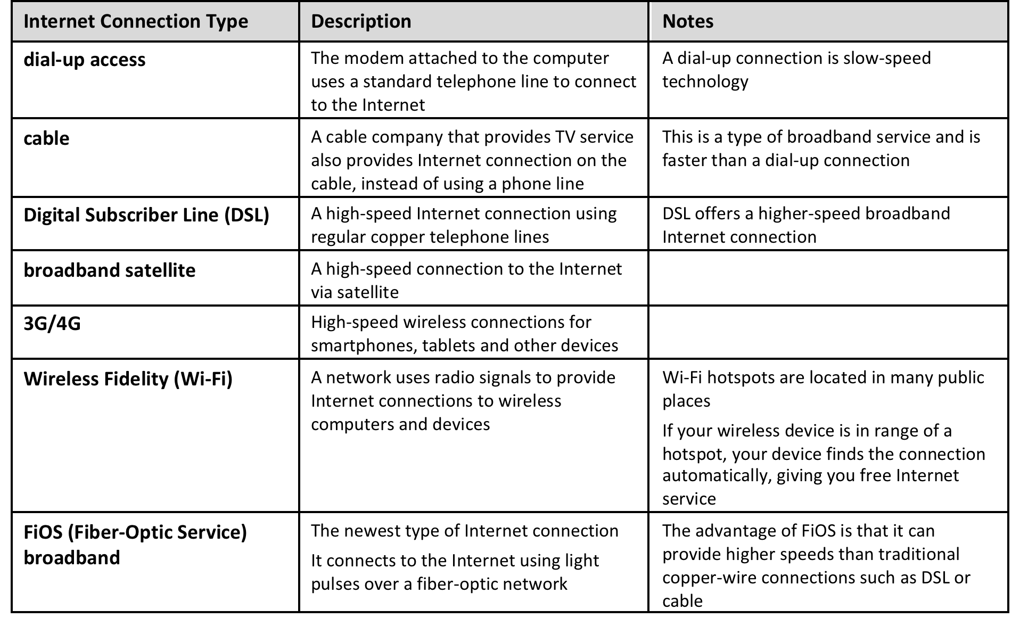
Types of connections
Notes:
Discuss types of connections – “Connecting to the Internet” video

Slide 11
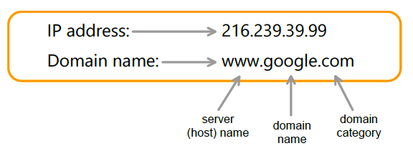
URL – DNS – IP address
URL
IP Address
www.google.com
www.google.com
216.239.39.99

Slide 12
Web addresses
Server name: name given to a server (usually “www” can be anything that helps distinguish it from other servers on the same network)
Domain name: the name registered to a specific Web site – usually a common name like “Google” “IBM” “Nike”
Top level domain: the 3rd part of a URL that tends to identify what “type” of Web site it is: edu, gov, com, etc.
All 3 parts together create a “unique” address just like a street address
www.google.com

Slide 13
Top level domains

Slide 14
Internet Communications World Wide Web

Slide 15
Key Web Technologies
Hypertext Markup Language (HTML) — the code used to format Web pages and create hyperlinks between documents.
Uniform Resource Locators (URLs) — the unique addresses for resources on the Web. Also called Uniform Resource Identifiers (URIs).
Hypertext Transfer Protocol (HTTP) — the communication rules for sending and receiving information online.

Slide 16
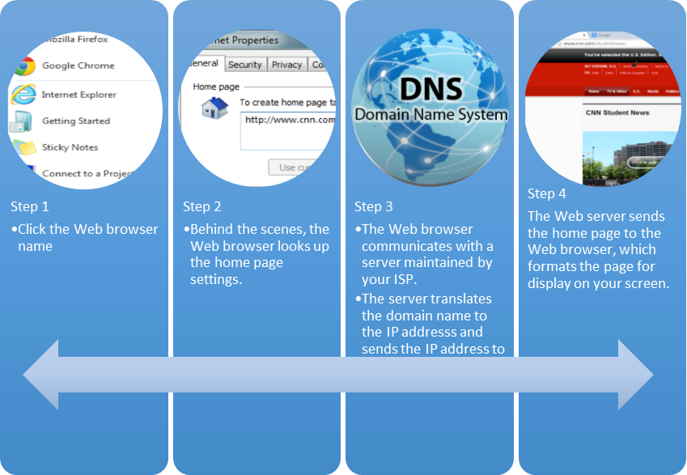
Web Browsers
Enables your computer to retrieve and display Web pages
Chrome, Firefox, Safari, Internet Explorer, and Opera
Not all browsers render the HTML page formatting with absolute consistency

Slide 17
Navigating the Web - Hyperlinks
Built-in connections to other related Web pages, programmed into the text on the page.
To another location within a page.
To another page within the same site.
To a completely different site.

Slide 18
Identifying Hyperlinks
Cursor changes to the shape of a hand when you hover it over a hyperlink.
Sometimes the hyperlink text will change colors.
Underlined text is a common convention for hyperlinks on older pages.
Once clicked, the hyperlink text pointing to that page will change to a different color, indicating that the page has already been viewed.

Slide 19
Other Uses for Links
Download a file to your computer.
Open an e-mail client and send a message pre-addressed to a person or service department.
Access content from search results when you search for information.

Slide 20
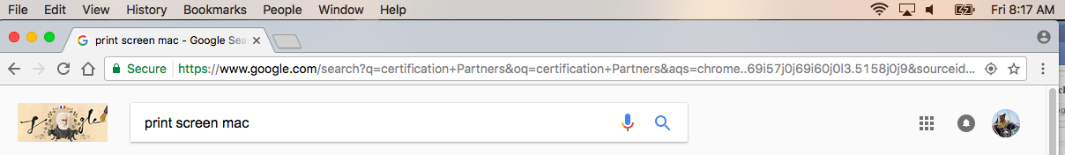
Browser tools
Back and Forward buttons - Address bar - Menu button
Reload button - Home button - Bookmarks or Favorites – New Tab

